Slide 1
COLOR IMAGES

Slide 2
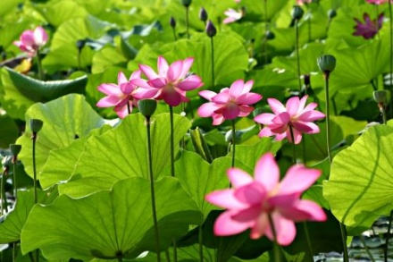
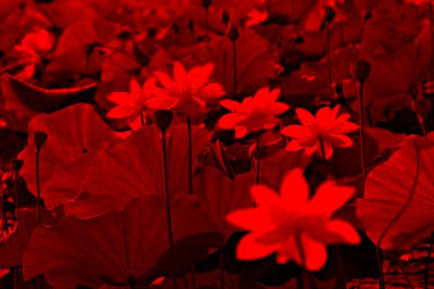
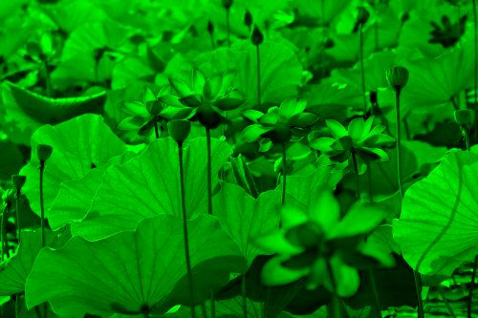
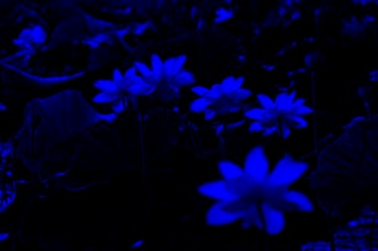
Color Images
Color images are comprised of three color channels – red, green, and, blue – which combine to create most of the colors we can see

Slide 3
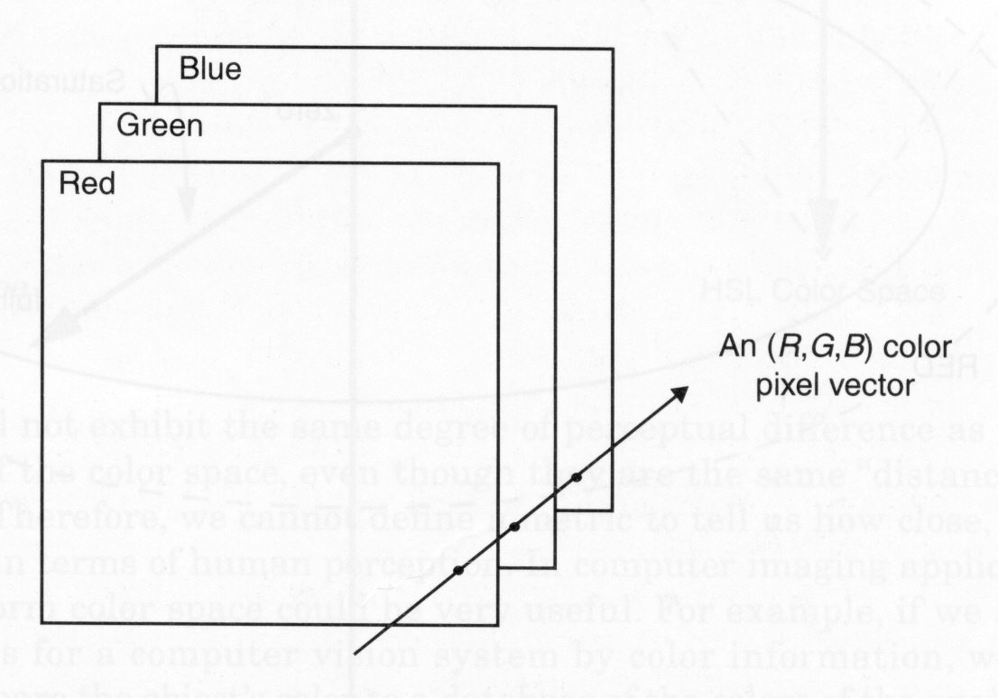
Color Images

Slide 4
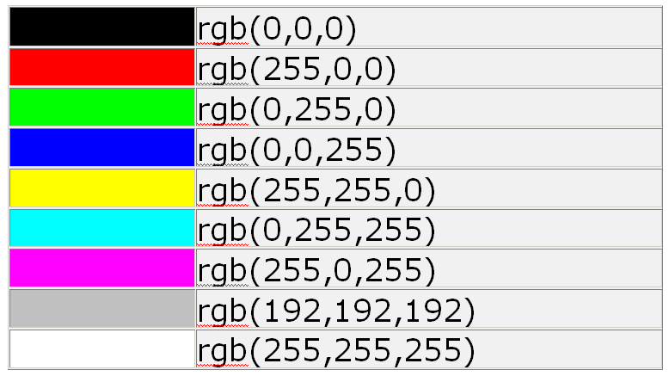
Color Images
This time a single pixel is made up of 3 bytes or 24 bits.

Slide 5
Alternative Color Spaces
Various other color representations can be computed from RGB.
This can be done for:
Decorrelating the color channels:
principal components.
Bringing color information to the fore:
Hue, saturation and brightness.
Perceptual uniformity:
CIELuv, CIELab, …

Slide 6
8 bit Colour Images and Look up Tables
Draw three blue dots
Pixel | Red | Green | Blue
1 RGB(0,0,255) | 0 (1 byte) | 0 (1 byte) | 255 (1 byte)
2 RGB(0,0,255) | 0 (1 byte) | 0 (1 byte) | 255 (1 byte)
3 RGB(0,0,255) | 0 (1 byte) | 0 (1 byte) | 255 (1 byte)
4 RGB(0,0,255) | 0 (1 byte) | 0 (1 byte) | 255 (1 byte)
No of bytes = 12

Slide 7
8 bit Colour Images and Look up Tables
Draw three blue dots
Pixel | Lookup table entry (size depends on size of ookup Table)
1 | 1 (1 byte)
2 | 1 (1 byte)
3 | 1 (1 byte)
4 | 1 (1 byte)
Lookup Table
Table Entry | Red | Green | Blue
1 RGB(0,0,255) | 0 (1 byte) | 0 (1 byte) | 255 (1 byte)
Reducing the number of bytes in this example from 12 to 7.
The GIF and PNG formats uses a look up table

Slide 8
Processing Strategy
Red
Red
Green
Green
T
Processing
T⁻¹
Blue
Blue

Slide 9
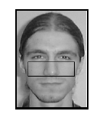
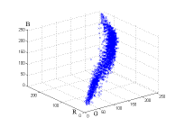
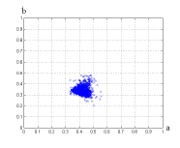

Skin color
RGB
rg
r
g

Slide 10
Skin detection
M. Jones and J. Rehg, Statistical Color Models with Application to Skin Detection, International Journal of Computer Vision, 2002

Slide 11
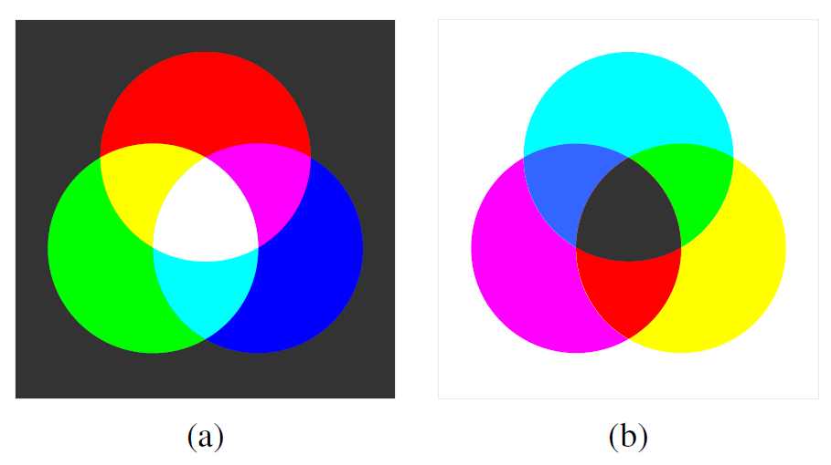
Color Images
Primary and Secondary Colors
Additive colors (projector, monitor)
Subtractive colors (printing, printing)

Slide 12
Alternative Color Spaces
RGB (CIE), RnGnBn (TV - National Television Standard Committee)
XYZ (CIE)
UVW (UCS de la CIE), U*V*W* (UCS modified by the CIE)
YUV, YIQ, YCbCr
YDbDr
DSH, HSV, HLS, IHS
Munsel color space (cylindrical representation)
CIELuv
CIELab
SMPTE-C RGB
YES (Xerox)
Kodak Photo CD, YCC, YPbPr, ...

Slide 13
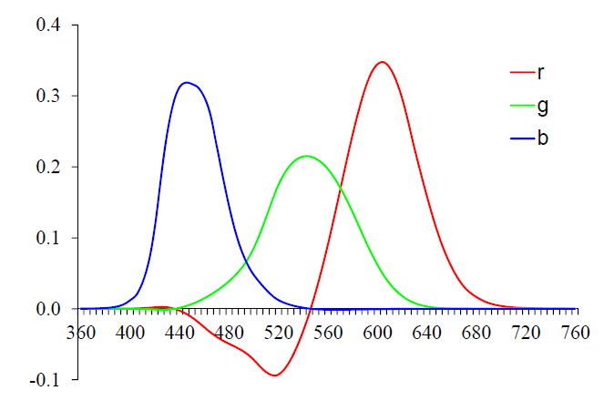
CIE color matching
Commission Internationale d’Eclairage (CIE)
Color matching experiments
pure colors to the R=700.0nm,
G=546.1nm, and B=435.8nm

Slide 14
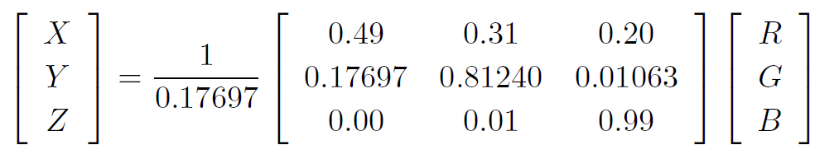
XYZ Color
Y=1 for pure R (1,0,0)

Slide 15
XYZ Color
Y=1 for (1,1,1)

Slide 16
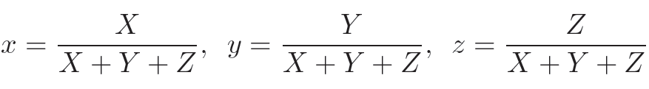
Alternative Color Spaces
Chromaticity coordinates
Yxy (luminance plus the two most distinctive chrominance components)

Slide 17
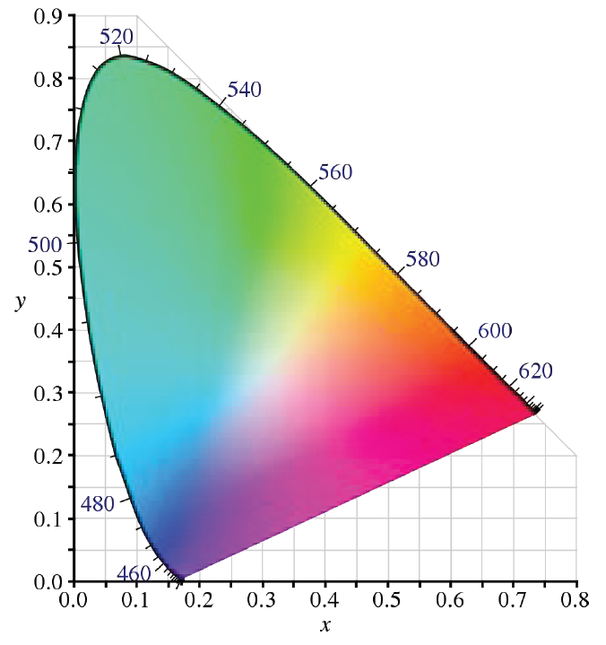
Chromaticity Diagram

Slide 18
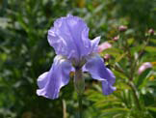
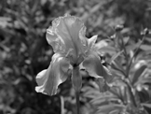
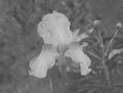
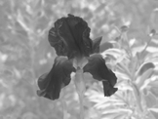
L*a*b* Color Space
Human visual system is roughly logarithmic
Differences in luminance or chrominance are more perceptually uniform
Non-linear mapping from XYZ to L*a*b* space

Slide 19
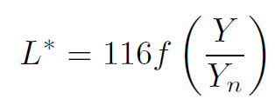
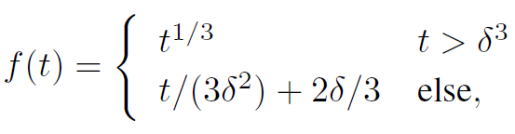
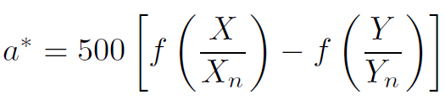
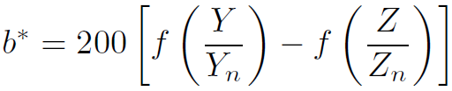
L*a*b* Color Space

Slide 20


YUV Color Space
YUV for video transmission
Luma
Two lower frequency chroma channels

Slide 21
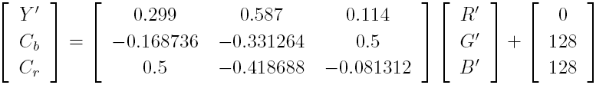
Crib Color Space
Closely related to YUV
Different scale factor to fit within the 8-bit range for digital signals
Useful for careful image de-blocking, et al.

Slide 22
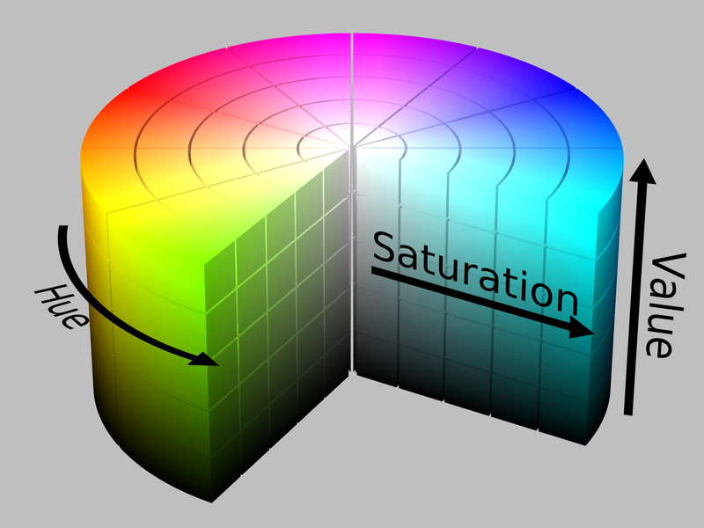
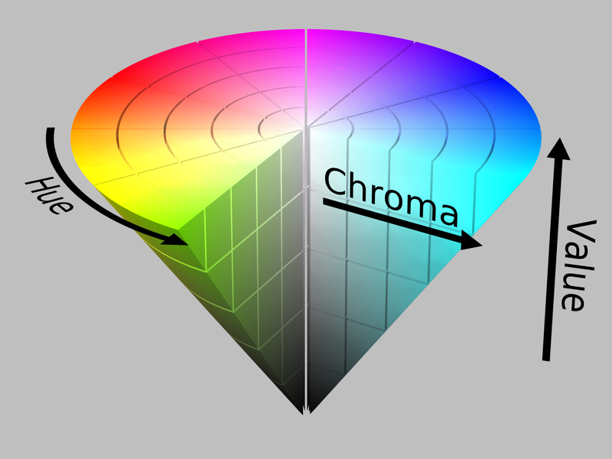
HSV Color Space
More suitable for color picking
Hue: direction around a color wheel
Saturation: scaled distance from the diagonal
Value: mean or maximum color value

Slide 23
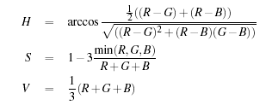

Color Transformation – Examples

Slide 24

HSV Color Space
Suitable for algorithms that only affect the value/luminance and not saturation or hue
After processing, scale rgb back by the color ratio Ynew/Yold
After processing, scale rgb back by the color ratio Ynew/Yold
Color FAQ, http://www.poynton.com/ColorFAQ.html

Slide 25
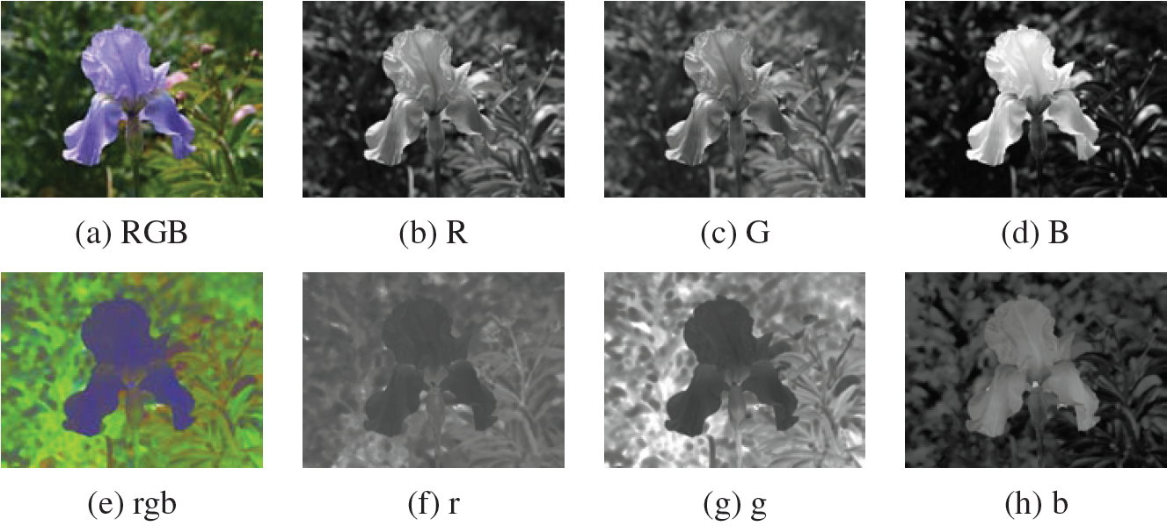
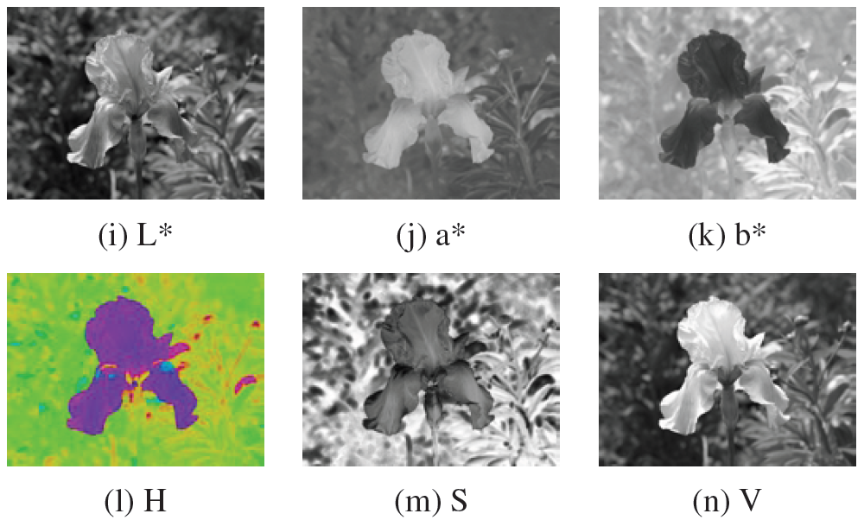

Slide 26
Image Properties (Texture)
Texture – small surface structure, either natural or artificial, regular or irregular
Texture Examples: wood barks, knitting patterns
Statistical texture analysis describes texture as a whole based on specific attributes: regularity, coarseness, orientation, contrast, …

Slide 27
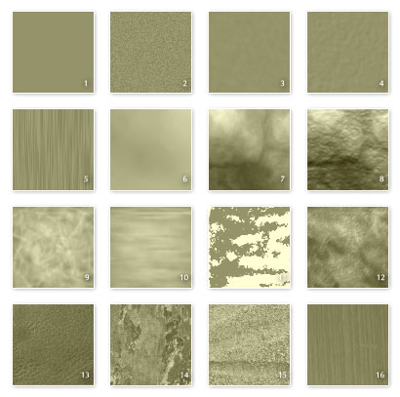
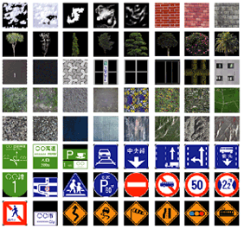
Texture Examples

Slide 28
END

